Slide 1
Machine Learning Modeling Algorithms
Module 3

Slide 2
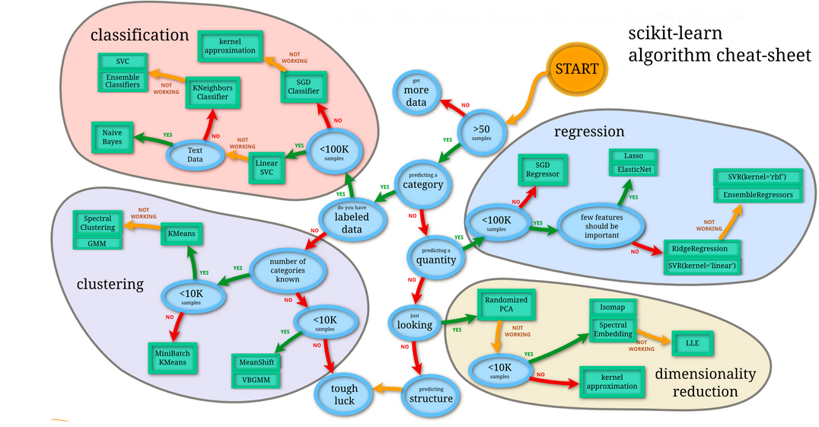
View larger image at: https://scikit-learn.org/stable/tutorial/machine_learning_map/

Slide 3
Machine Learning Modeling Algorithms
Machine Learning is the field of study that gives computers the ability to learn without being explicitly programmed.
The idea is that there are generic algorithms that can tell you something interesting about a set of data without having to write any custom code specific to the problem.
This magic is possible because the system learns from the data features of the object in question.
The key pieces of Machine Learning are:
Data
Features selection and feature engineering
Algorithms

Slide 4
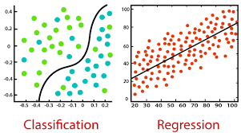
Machine Learning Algorithms
Supervised Learning algorithms: in supervised learning, the data is labeled. Algorithms are used for regression (prediction) or classifications. Some well know algorithms in this category are:
Linear Regression (prediction)
Logistic Regression ( classification)
Decision Trees and Random Forests (prediction and classification)
Support Vector Machines ( classification)
K-Nearest Neighbors (classification)
Neural networks (predication and classification)

Slide 5
Types of Machine Learning Algorithms
Unsupervised Learning: data has no labels; the goal of the algorithm is to find relationships in the data. Unsupervised learning is often used for clustering data in different groups.
Clustering: k-Means
Visualization and dimensionality reduction
Principal Component Analysis (PCA), t-distributed

Slide 6
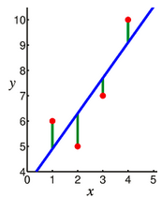
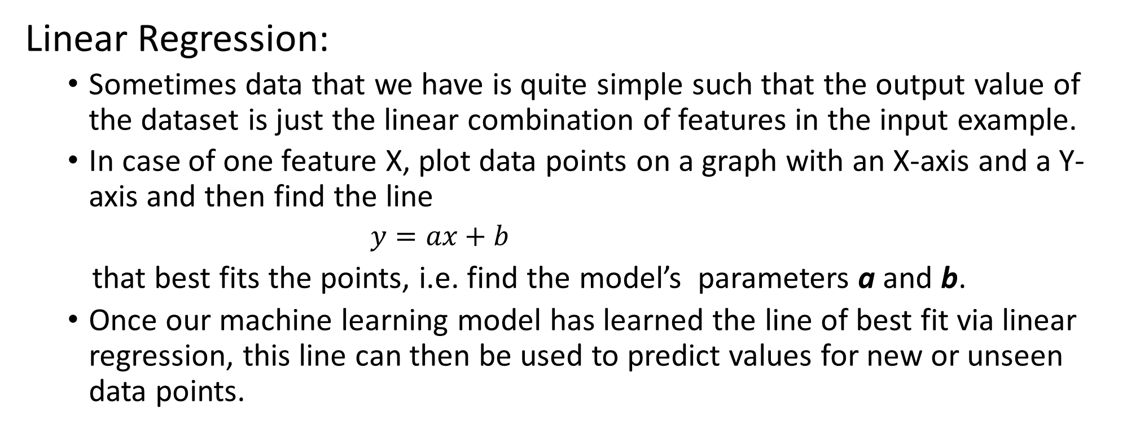
Linear Regression:
Sometimes data that we have is quite simple such that the output value of the dataset is just the linear combination of features in the input example.
In case of one feature X, plot data points on a graph with an X-axis and a Y-axis and then find the line
$y=ax+b$
that best fits the points, i.e. find the model’s parameters a and b.
Once our machine learning model has learned the line of best fit via linear regression, this line can then be used to predict values for new or unseen data points.

Slide 7
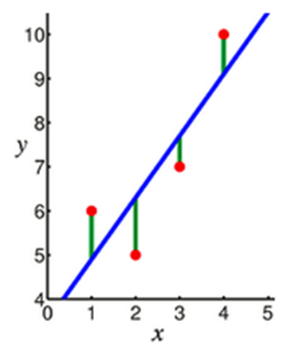
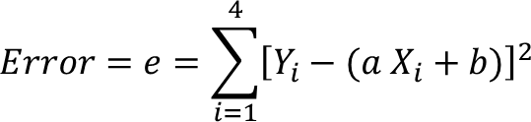
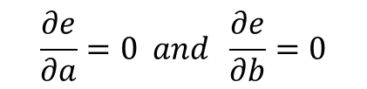
The most popular methods for linear regression is the least squares method that find the model’s parameter in such a way that minimizes the sum of square of the differences between the actual (label) and the predicted value, which is designated as error in prediction.
Some other model performance metrics that can be used to assess the performance of a regression are R-Squared, RMSE : Root Mean Squared Error, MAE : Mean Absolute Error.
X | Y
1 | 6
2 | 5
3 | 7
4 | 10
Techniques from calculus is used to minimize the error, which leads to solving the following system of equations:
$$\frac{∂e}{∂a}=0 and \frac{∂e}{∂b}=0$$

Slide 8
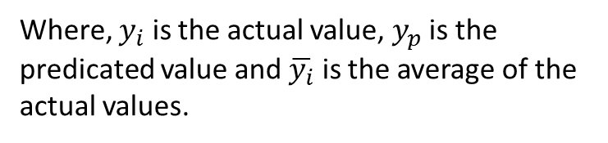
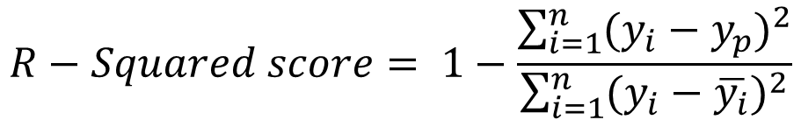
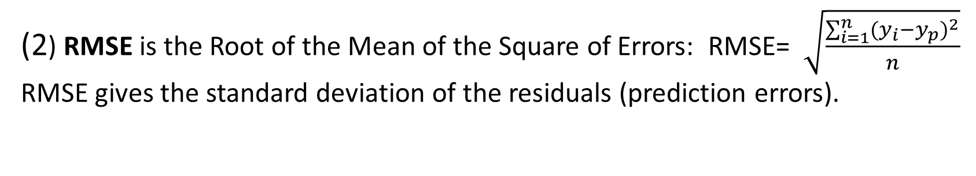
Metrics for performance measure of a regression Modeler :
(1) R-Squared score: R-Squared value is always between 0 and 1. A R-squared value of 0.98 indicates that 98% of the predictions are correct.
$$R−Squared score= 1−\frac{\sum_{i=1}^{n}{{(y_{i}−y_{p})}^{2}}}{\sum_{i=1}^{n}{{(y_{i}−\overline{y_{i}})}^{2}}}$$
Where, $y_{i}$ is the actual value, $y_{p}$ is the predicated value and $\overline{y_{i}}$ is the average of the actual values.
(2) RMSE is the Root of the Mean of the Square of Errors: RMSE= $\sqrt{\frac{\sum_{i=1}^{n}{{(y_{i}−y_{p})}^{2}}}{n}}$
RMSE gives the standard deviation of the residuals (prediction errors).
(3) MAE is the Mean of Absolute (Average) of Errors: MAE = $\frac{\sum_{i=1}^{n}{\left|(y_{i}−y_{p})\right|}}{n}$
Scikit-learn provides metrics library to calculate these values:
from sklearn.metrics import r2_score. Example: r2_score(y_true, y_pred) from sklearn.metrics import mean_squared_error . Example: mean_squared_error(y_true, Y_pred)
For additional information see: https://towardsdatascience.com/what-are-rmse-and-mae-e405ce230383

Slide 9


Linear regression in scikit-learn: import the algorithm as well as the needed metrics.
Next, import function for splitting the data into training and testing
Create an instance of the LinearRegression algorithm object and call the function fit in the object
Now, we can make predictions on the test data set.

Slide 10
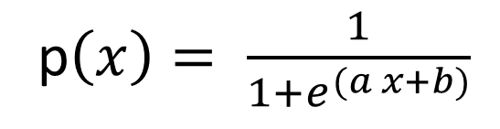
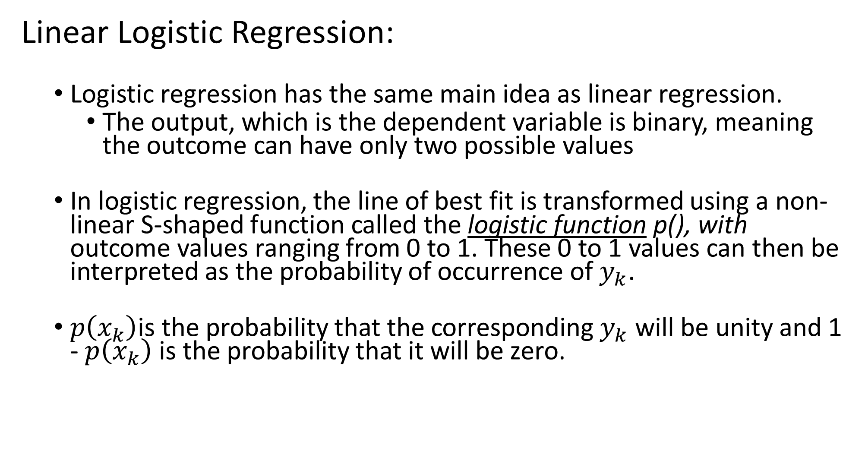
Linear Logistic Regression:
Logistic regression has the same main idea as linear regression.
The output, which is the dependent variable is binary, meaning the outcome can have only two possible values
In logistic regression, the line of best fit is transformed using a non-linear S-shaped function called the logistic function p(), with outcome values ranging from 0 to 1. These 0 to 1 values can then be interpreted as the probability of occurrence of $y_{k}$.
$p\left(x_{k}\right)$is the probability that the corresponding $y_{k}$ will be unity and 1 - $p\left(x_{k}\right)$ is the probability that it will be zero.
p$\left(x\right)= \frac{1}{1+e^{(a x+b)}}$

Slide 11
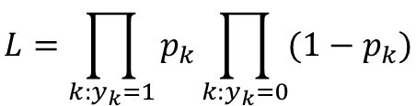
We set a threshold or cut-off value to 0.5. All instances with a probability higher than this threshold will be classified as instances belonging to class 1 , while all those having probability below the threshold will be assigned to class 0.
The measure of goodness of fit is given by the likelihood function, which is the probability that the given data set is produced by a particular logistic function:
$$L=\prod_{k:y_{k}=1}{p_{k}\prod_{k:y_{k}=0}{(1−p_{k})}}$$

Slide 12
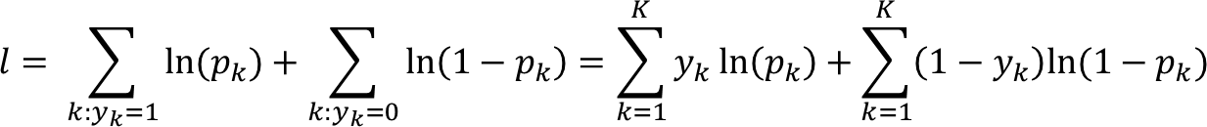
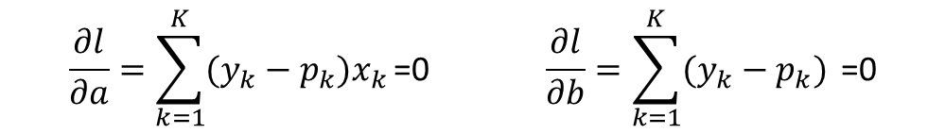
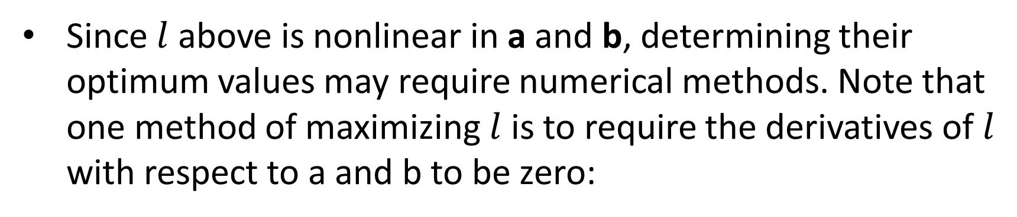
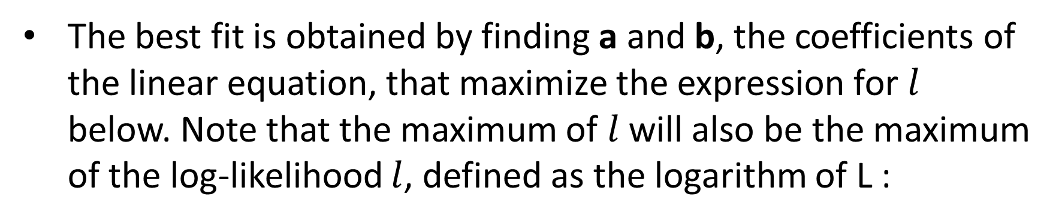
The best fit is obtained by finding a and b, the coefficients of the linear equation, that maximize the expression for $l$ below. Note that the maximum of $l$ will also be the maximum of the log-likelihood $l$, defined as the logarithm of L :
Since $l$ above is nonlinear in a and b, determining their optimum values may require numerical methods. Note that one method of maximizing $l$ is to require the derivatives of $l$ with respect to a and b to be zero:
$$\frac{∂l}{∂a}=\sum_{k=1}^{K}{(y_{k}−p_{k})x_{k}}\text{=0} \frac{∂l}{∂b}=\sum_{k=1}^{K}{(y_{k}−p_{k}) }\text{=0}$$

Slide 13


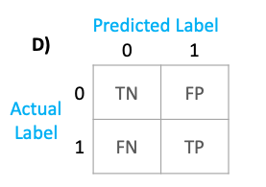
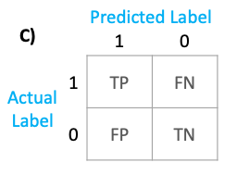
Measuring Performance of classification models:
A confusion matrix is a table that is often used to describe the performance of a classification model
Positive (P) : Observation is positive (for example “is an apple”).
Negative (N) : Observation is not positive (for example “is not an apple”).
True Positive (TP) : Observation is positive and is predicted to be positive.
False Negative (FN) : Observation is positive but is predicted negative.
True Negative (TN) : Observation is negative and is predicted to be negative.
False Positive (FP) : Observation is negative but is predicted positive.

Slide 14
Accuracy: measures the percentage of correctly predicted data against the total data. This is a metric that is best used for a balanced data set. Accuracy = (TP + TN) / (TP + TN + FP + FN).
Precision: quantifies the number of correct positive predictions made. This is a metric that can be used for an unbalanced data set. Precision = (TP) / (TP + FP)
Recall / Sensitivity: Calculated as the number of true positives divided by the total number of true positives and false negatives. This is a metric that can be used for an unbalanced data set. Recall = (TP) / (TP + FN)
Specificity: (also called the true negative rate) measures the proportion of actual negatives that are correctly identified as such. This metric is used to maximize True negative rate. Specificity = (TN) / (TN + FP)
F1 Score: measure provides a way to combine both precision and recall into a single measure that captures both properties. F1 Score is comparison of average from precision and recall that’s weighted.
F1 Score = 2 * (Recall*Precision) / (Recall + Precision)

Slide 15

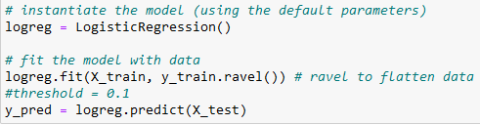
Linear Logistic regression in scikit-learn, import the algorithm as well as the needed metrics.
Next, import function for splitting the data into training and testing
Create an instance of the LogisticRegression algorithm object and call the function fit in the object and predict

Slide 16

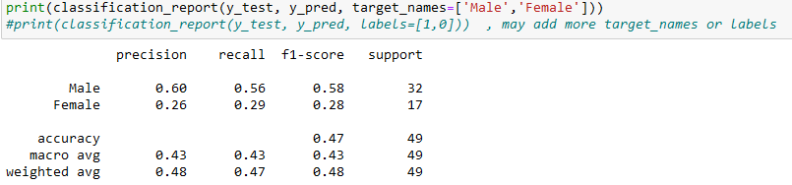
For the performance of the Logistic Regression, we can use the R-score
We can also generate the confusion matrix as well
It is often desired to generate the confusion matrix report with precision, recall and f1-score.

Slide 17
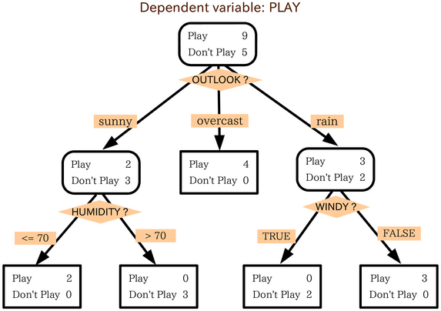
Decision Trees
Decision Trees also belong to the category of supervised learning algorithms, but they can be used for solving both regression and classification tasks.
The training model learns to predict values of the target variable by learning decision rules with a tree representation.
A tree is made up of nodes corresponding to a feature or attribute.
The final nodes, leaf nodes, correspond to a class label/predicted value.

Slide 18
There are various ways to obtain the decision tree from the data:
CART ( classification and regression)
ID3
CHAID
ID45
We will discuss the CART method:
It uses the GINI index as the metric or the cost function to evaluate the split in feature selection.

Slide 19
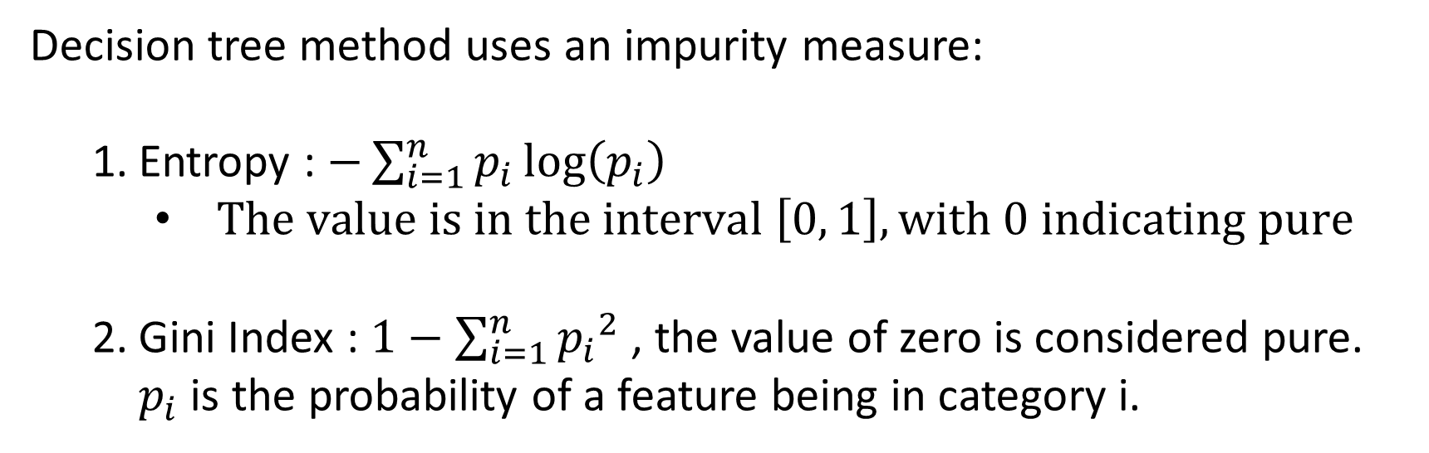
Decision tree method uses an impurity measure:
Entropy : $−\sum_{i=1}^{n}{p_{i}\log\left(p_{i}\right) }$
$The value is in the interval \left[0, 1\right],with 0 indicating pure$
Gini Index : $1−\sum_{i=1}^{n}{{p_{i}}^{2}}$ , the value of zero is considered pure. $p_{i}$ is the probability of a feature being in category i.

Slide 20
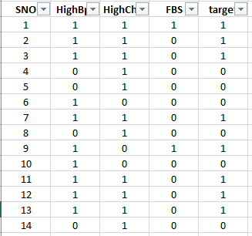
Consider the simulation with heart disease with 14 rows and has 4 attributes. Target (rightmost column) consist of 6 value 0 (no) and 8 value 1 (yes).
Let’s use the Gini index to build a decision tree from the dataset. In practice, the Gini index can be interpreted as the following equation

Slide 21
The lower value of Gini index indicates the least amount of impurity in information. So, the feature with the lowest Gini index (Impurity) value on the first iteration will be selected as the Root Node.
The first step in creating a decision tree, is the splitting of the data:
To split a decision tree using Gini Impurity, the following steps need to be performed.
For each possible split, calculate the Gini Impurity of each child node
Calculate the Gini Impurity of each split as the weighted average Gini Impurity of child nodes
Select the split with the lowest value of Gini Impurity
Repeat steps 1–3 until no further split is possible.

Slide 22

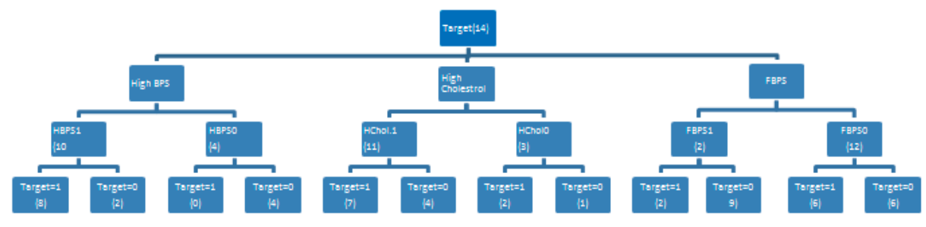
The dataset
The full decision tree for the table

Slide 23
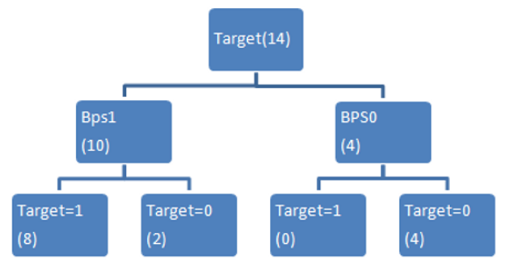
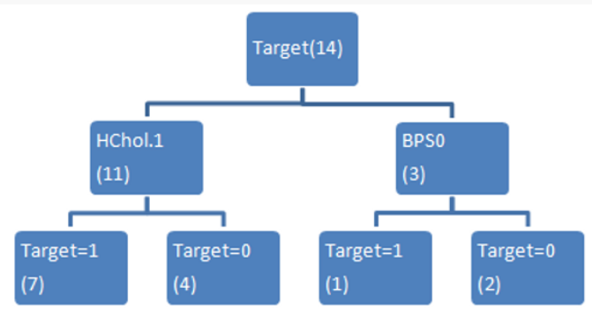
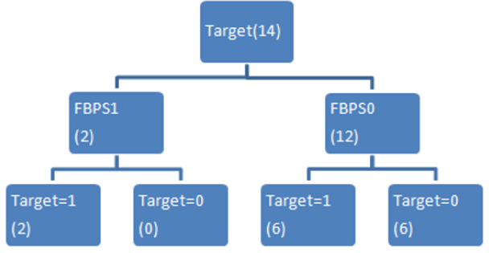
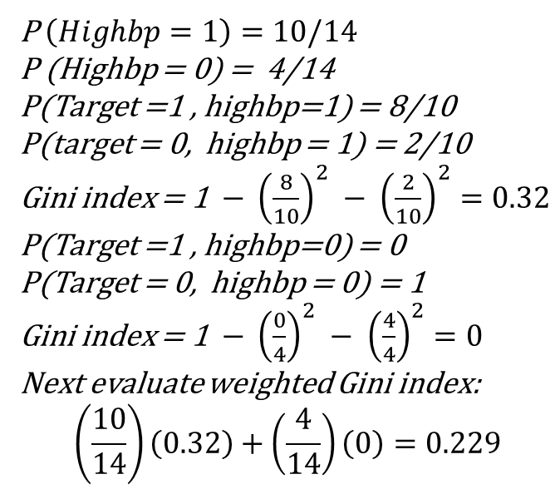
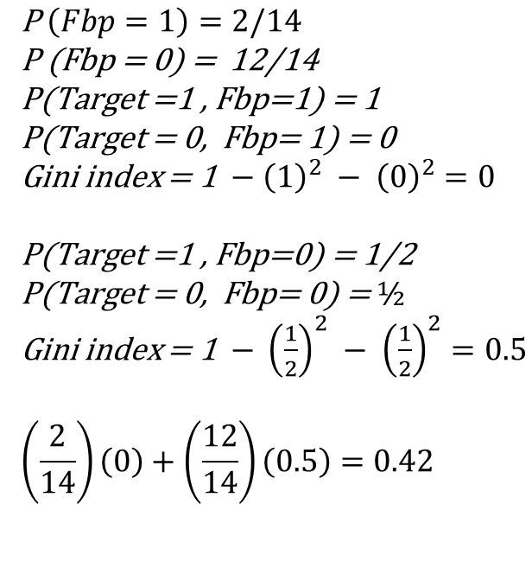
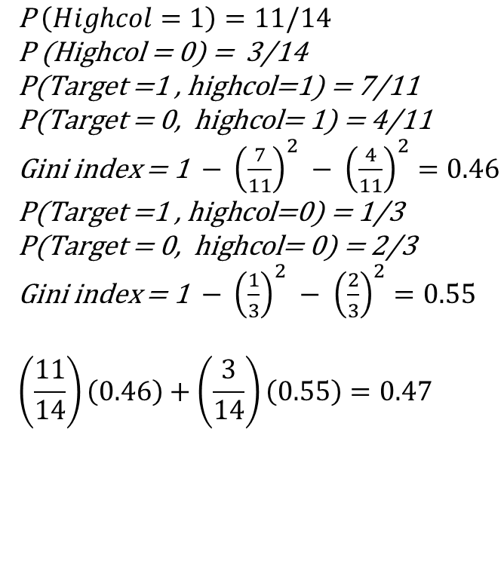
Split Bps
Split Hcol
Split Fbp
$$\text{P} \left(Highcol=1\right)=11/14$$
$$\text{P}\text{ (}\text{High}\text{col}\text{ = 0) = }\text{3}\text{/14}$$
$$\text{P}\text{(}\text{Target}\text{ =1 , }\text{high}\text{col}\text{=1) = }\text{7}\text{/1}\text{1}$$
$$\text{P}\text{(}\text{Ta}\text{rget}\text{ = 0, }\text{high}\text{col}\text{= 1) = }\text{4}\text{/1}\text{1}$$
Gini index = 1 $− {\left(\frac{7}{11}\right)}^{2} − {\left(\frac{4}{11}\right)}^{2}=0.46$
$$\text{P}\text{(}\text{Target}\text{ =1 , }\text{highcol}\text{=0) = 1/3}$$
$$\text{P}\text{(}\text{Ta}\text{rget}\text{ = 0, }\text{high}\text{col}\text{= }\text{0}\text{) = }\text{2}\text{/}\text{3}$$
Gini index = 1 $− {\left(\frac{1}{3}\right)}^{2} − {\left(\frac{2}{3}\right)}^{2}=0.55$
$$\left(\frac{11}{14}\right)\left(0.46\right)+\left(\frac{3}{14}\right)\left(0.55\right)=0.47$$
$$\text{P} \left(Fbp=1\right)=2/14$$
$$\text{P}\text{ (}\text{Fbp}\text{ = 0) = }\text{12/}\text{14}$$
$$\text{P}\text{(}\text{Target}\text{ =1 , }\text{Fbp}\text{=1) = }\text{1}$$
$$\text{P}\text{(}\text{Target}\text{ = 0, }\text{Fbp}\text{= 1) = 0}$$
Gini index = 1 $− {\left(1\right)}^{2} − {\left(0\right)}^{2}=0$
$$\text{P}\text{(}\text{Target}\text{ =1 , }\text{Fbp}\text{=0) = }\text{1/2}$$
$$\text{P}\text{(}\text{Target}\text{ = 0, }\text{Fbp}\text{= 0) = }½$$
Gini index = 1 $− {\left(\frac{1}{2}\right)}^{2} − {\left(\frac{1}{2}\right)}^{2}=0.5$
$$\left(\frac{2}{14}\right)\left(0\right)+\left(\frac{12}{14}\right)\left(0.5\right)=0.42$$
P $\left(Highbp=1\right)=10/14$
P (Highbp = 0) = 4/14
P(Target =1 , highbp=1) = 8/10
P(target = 0, highbp = 1) = 2/10
Gini index = 1 $− {\left(\frac{8}{10}\right)}^{2} − {\left(\frac{2}{10}\right)}^{2}=0.32$
P(Target =1 , highbp=0) = 0
P(Target = 0, highbp = 0) = 1
Gini index = 1 $− {\left(\frac{0}{4}\right)}^{2} − {\left(\frac{4}{4}\right)}^{2}=0$
Next evaluate weighted Gini index:
$$\left(\frac{10}{14}\right)\left(0.32\right)+\left(\frac{4}{14}\right)\left(0\right)=0.229$$
Select the feature with smallest weighted Gini index as root of the decision tree.

Slide 24
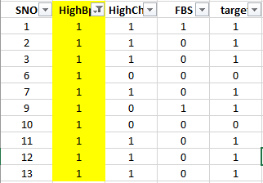
Select High blood pressure as the root of the tree. Then construct the rest of the decision tree in a similar manner. This means, we start with the Highbp as the root node, with edges “yes” and “no”. Start with the “yes” edge.
What are possible splits, either HighCol and the next node or FBPS. We need to decide which feature, Highcol or FBPs, should be the next node. Keep in mind that we are assuming that Highbp = 1, see table below.

Slide 25
With Highbp = 1, we will compute the weighted Gini index of Highcol and FBPS as we did before.
select the feature with smallest weighted Gini Index for the next node.
We will do the same calculation for the “no” edge coming out of the root as well. As indicated earlier, we continue this process until no further split is possible
Notes on Decision tree was taken from the article:
https://www.numpyninja.com/post/understanding-the-gini-index-in-decision-tree-with-an-example

Slide 26
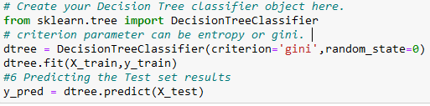
Decision Tree in scikit-learn, import the algorithm, fit and predict.
We can use the confusion matrix to evaluate the results for the classification problem or the metrics for the
Predictions.

Slide 27

Naive Bayes
Based on the Bayes Theorem. It is called naive because the classifier assumes that the input variables are independent of each other
The Bayes theorem is given by the formula:
Say we have a training dataset with observations on features of the weather condition, X = (outlook, temp, humid, Windy) and the corresponding target variable C= (play, not play). We can use the dataset to obtain the probability of, say, “Players will play if it is rainy”, P(Play | outlook=rainy). Note that even through the answer is a numerical value ranging from 0 to 1, this is still an example of a classification problem — we can use the probabilities to reach a “yes/no” outcome.

Slide 28
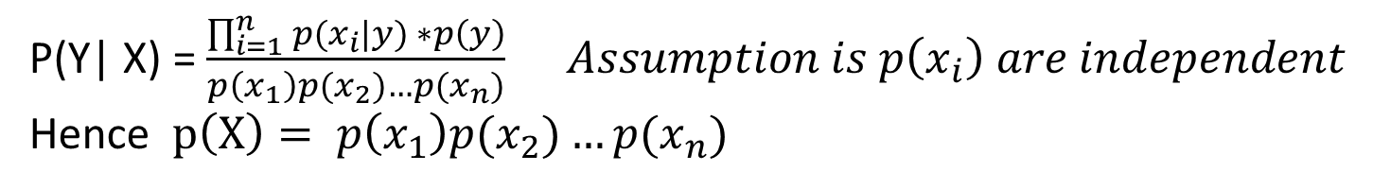
Consider the partial dataset below with four features, for weather condition and one target “play”
 | outlook | temp | Humidity | Windy | play
0 | Rainy | Hot | High | False | No (not play)
1 | Rainy | Hot | High | True | No (not play)
2 | Overcast | Hot | High | False | Yes (play)
3 | Sunny | Mild | High | False | Yes (play)
: | : | : | : | : | :
According to the table, with feature set: X=(Rainy, Hot, High, False), there was no play.
Our objective here is to find the probability that the game is played given the conditions feature set X using Naïve Bayes formula
P(Y| X) = $\frac{\prod_{i=1}^{n}{p(x_{i}|y)} ∗p\left(y\right)}{p\left(x_{1}\right)p(x_{2})…p(x_{n})} Assumption is p\left(x_{i}\right) are independent$
Hence $p\left(X\right)= p\left(x_{1}\right)p(x_{2})…p(x_{n})$

Slide 29
First, we need to find the probability of events needed in Bayes formula from the dataset, assume the following tables were created from the original data set
Outlook | yes | no | p(y) | P(n)
Sunny | 2 | 3 | 2/9 | 3/5
Overcast | 4 | 0 | 4/9 | 0/5
Rainy | 3 | 2 | 3/9 | 2/5
total | 9 | 5 | 100% | 100%
Temp | yes | no | p(y) | P(n)
Hot | 2 | 2 | 2/9 | 2/5
Mild | 4 | 2 | 4/9 | 2/5
Cool | 3 | 1 | 3/9 | 1/5
total | 9 | 5 | 100% | 100%
P(Hot | played) = 2/9
P(Cool | not played) = 1/5
With respect to the outlook feature, out of the 14 days, 9 days were played, and 5 days were not played.
Humidity | yes | no | p(y) | p(n)
High | 3 | 4 | 3/9 | 4/5
normal | 6 | 1 | 6/9 | 1/5
total | 9 | 5 | 100% | 100%
Wind | yes | no | p(y) | P(n)
False | 6 | 2 | 6/9 | 2/5
True | 3 | 3 | 3/9 | 3/5
total | 9 | 5 | 100% | 100%
P(windy | played) = 3/9
Play | yes | probability
Yes | 9 | 9/14
No | 5 | 5/14
total | 14 | 100%
P(play) = 9/14

Slide 30
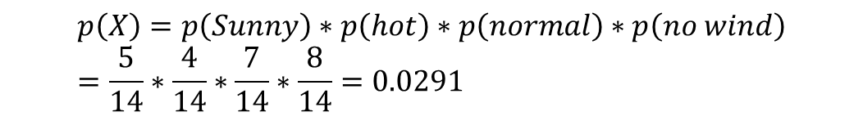
We are able now to make predictions using Bayes theorem. Suppose today is (sunny, hot, normal, no windy), predict whether there will be a game
$$p\left(yes | today\right)=\frac{p\left(sunny | yes\right) p\left(hot | yes\right) p\left(normal | yes\right) p\left(no wind | yes\right)∗ p(y)}{p(today)}$$
$$p\left(no | today\right)=\frac{p\left(sunny | no\right) p\left(hot | no\right) p\left(normal | no\right) p\left(no wind | no\right) ∗p(y)}{p(today)}$$
$$p\left(X\right)=p\left(Sunny\right)∗p\left(hot\right)∗p\left(normal\right)∗p\left(no wind\right)=\frac{5}{14}∗\frac{4}{14}∗\frac{7}{14}∗\frac{8}{14}=0.0291$$
$$p\left(yes | today\right) : \left(\frac{2}{9}∙\frac{2}{9}∙\frac{6}{9}∙\frac{6}{9}.\frac{9}{14}\right) ∗ \frac{1}{P\left(X\right)}=0.0141∗\frac{1}{0.0291}=0.484$$
$$p\left(no | today\right) : \left(\frac{3}{5}∙\frac{2}{5}∙\frac{1}{5}∙\frac{2}{5}∙\frac{5}{14}\right)∗\frac{1}{P\left(X\right)}=0.0068∗\frac{1}{0.0291}=0.233$$
Predict depends on the threshold, taking above p > 0.5 as play, we see that the Prediction is no play

Slide 31



The Scikit-learn commands for creating, training and fitting a dataset using Naïve Bays algorithms are shown below:

Slide 32
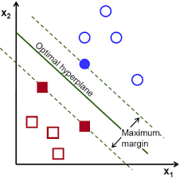
Support Vector Machine (SVM)
A supervised algorithm for classification problems. It plots each data item as a point in n-dimensional space, where n is the number of input features.
SVM finds an optimal boundary, called a hyperplane, that best separates the possible outputs by their class label.
The task of the SVM algorithm is to find the coefficients that provide the best separation of classes by this hyperplane.
The distance between the hyperplane and the closest class point is called the margin. The optimal hyperplane is one that has the largest margin that classifies points in such a way that the distance between the closest data point from both classes is maximum.

Slide 33
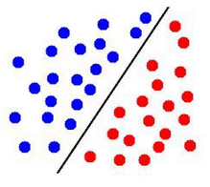
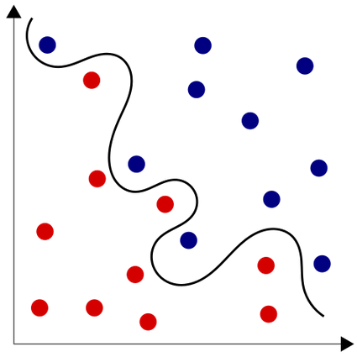
The Support Vector Machine(SVM) as a classifier can conveniently perform tasks for both linearly separable and non-linearly separable data points, using kernel functions
Data points can be said to be linearly separable if a separating boundary/hyperplane can easily be drawn showing distinctively the different class groups. Linear separable data points mostly require linear machine learning classifiers such as Logistic regression for example.
Non-Linearly Separable data points: This is opposite of Linearly separable data point we cannot draw a straight line to separate the points. SVM uses Kernel functions to represent these data points in a higher-dimensional space and then finds the optimal separating hyperplane.

Slide 34
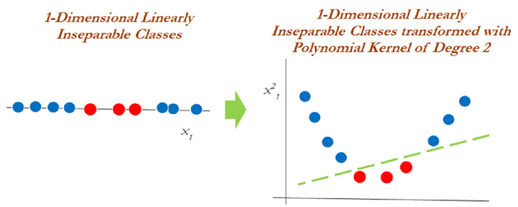
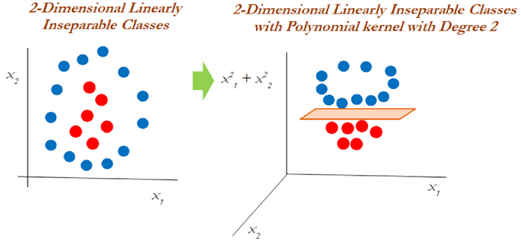
Examples where a Kernel function is applied to non-linearly separable dataset.
Here are some of widely used kernel functions: (1) Linear function kernel, (2) Polynomial function kernel, (3) Radial Basis Function kernel (RBF), which could be either Gaussian or Laplace. This is dependent on a hyperparameter known as gamma, (4) The Sigmoid Function that finds more application in neural networks as an activation function. This function is used in image classification.

Slide 35


The Scikit-learn commands for creating, training and fitting a dataset using SVM algorithms are shown below:

Slide 36
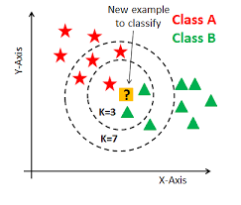
K-Nearest Neighbors (KNN)
K nearest neighbors is a supervised machine learning algorithm often used in classification problems.
This algorithm works by classifying the data points based on how the neighbors are classified.
Technically, the algorithm classifies an unknown item by looking at k of its already -classified, nearest neighbor items by finding out majority votes from nearest neighbors that have similar attributes as those used to map the items.

Slide 37

The selection of k is critical here; a small value can result in a lot of noise and inaccurate results, while a large value is not feasible and defeats the purpose of the algorithm.
The process of choosing the right value of K is referred to as parameter tuning and is of great significance in achieving better accuracy.
KNN algorithm is a good choice if you have a small dataset, and the data is noise free and labeled.
The distance functions for assessing similarity between instances can be Euclidean, Manhattan, or Minkowski distance.

Slide 38
The Scikit-learn commands for creating, training and fitting a dataset using KNN algorithms are shown below.
P is the parameter used in Minkowski distance.

Slide 39
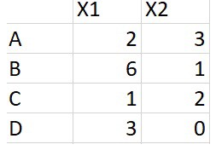
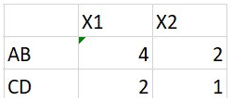
K-Means
K-means is a type of unsupervised algorithm
It tries to find K groups of clusters in the dataset, where each data point will belong to a group.
Algorithm starts with initial estimates of K centroids, randomly selected from the dataset
Consider the dataset:
Suppose we go with k = 2, two clusters. For the initial two centroids take the average values of in A and B and the average values of C and D

Slide 40
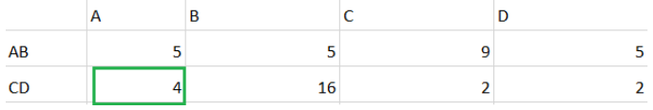
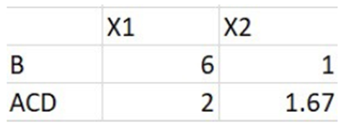
Calculate squared Euclidean distance between all data points to the centroids AB, CD. As an example, distance between A(2,3) and AB (4,2) is given by s = (2–4)² + (3–2)².
The distance between (A, CD) is 4 and is less compared to (AB, A) which is 5. Since point A is close to the CD we can move A to CD cluster.
Recompute the centroids for clusters B and ACD = average of A, C, D

Slide 41

Calculate the distance of all points (A, B, C, D) to new centroids (B, ACD )
All data points are assigned to clusters (B, ACD ) based on their minimum distance. The iterative procedure ends here.
Choosing K: run K-Means clustering for a range of K values, say ( K= 1 to 10 ) and calculate the Sum of Squared Error (SSE). The SSE is calculated as the mean distance between data points and their cluster centroid. Plot the value of k vs. SSE and the select the value of K corresponding to smallest SSE.
Reference: https://towardsdatascience.com/k-means-clustering-for-beginners-2dc7b2994a4

Slide 42
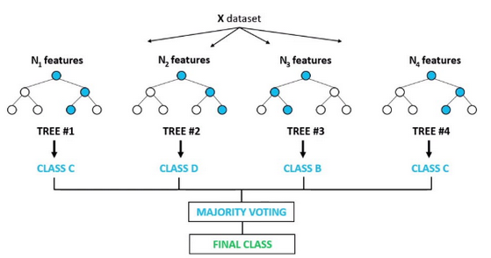
Random Forest
Random Forest is an ensemble of decision trees. The vote of decision trees are combined to make a final decision; majority vote wins.
Random forests algorithm can be used for feature selection process. This algorithm can be used to rank the importance of variables in a regression or classification problem.

Slide 43
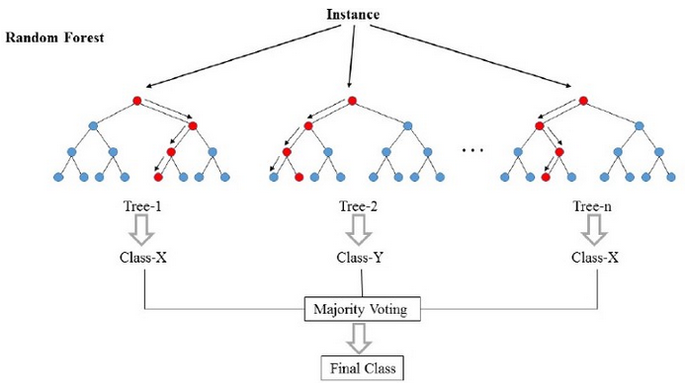
Random Forest works on classification and Regression.
Random Forest uses N number of Decision Tree as base model and give some random sample of the data to each Decision Tree to predict.
for classification, Random Forest take every output of Decision Tree and do voting whichever class has highest voting it take that as output.
Random Forest reduce the overfitting of Decision Tree models and helps to improve accuracy. It require much time as it combine so many trees.

Slide 44
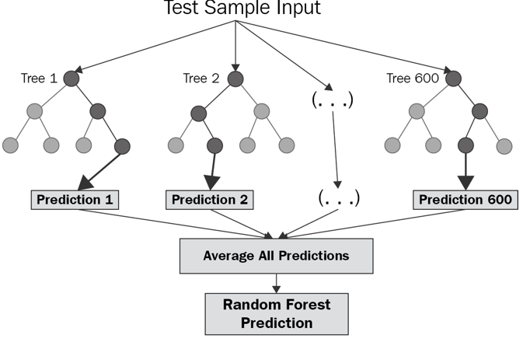
For Regression problems, Random Forest take average of every numeric output.

Slide 45
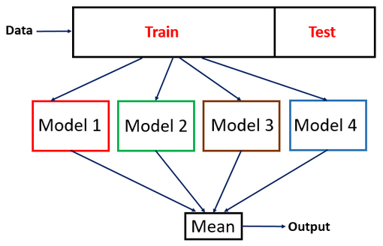
Ensemble Method
Ensemble methods use multiple learning algorithms to obtain better predictive performance. We train various models, aggregating their predictions as shown below:

Slide 46
There are two main classes of ensemble learning methods, namely bagging and boosting
Bagging method builds models in parallel using a random subset of data (sampling with replacement) and aggregates predictions of all models
Boosting method builds models in sequence using the whole data, with each model improving on the previous model’s error

Slide 47
XGBOOST
Gradient boosting is one of the variants of ensemble methods where you create multiple weak models and combine them to get better performance as a whole.
XGBoost is a data science library for performing classification and regression.
XGBoost makes use of gradient boosted decision tree, which provides better performance than regular decision trees.
Gradient boosting combines many decision trees into a single model for classification or regression.
Gradient boosting starts off with a single decision tree and iteratively adds more decision trees to the overall model to correct the model's errors on the training dataset.
XGBoot has its own APIs, different from Scikit-Learn. However, for simplicity it provides an API wrapper for Scikit-Learn user called XGBClassifier.
After training an XGBoost model, we can view the relative (proportional) importance of each dataset feature using the feature_importances_ property of the model.
We can plot the feature importance for a model using the plot_importance function.

Slide 48



Create a an XGBClassifier object and use to fit the model and make predictions.
Default importance type is the use of the feature in more decision trees
The gain importance type is based on. which means that we use information gain as the importance metric. Information gain is a commonly used metric for determining how good a feature is at differentiating the dataset, which is important in making predictions with a decision tree.

Slide 49
END

